Slide 1

NDMA CUAS Specialist Course – LRU Replacement

Slide 2

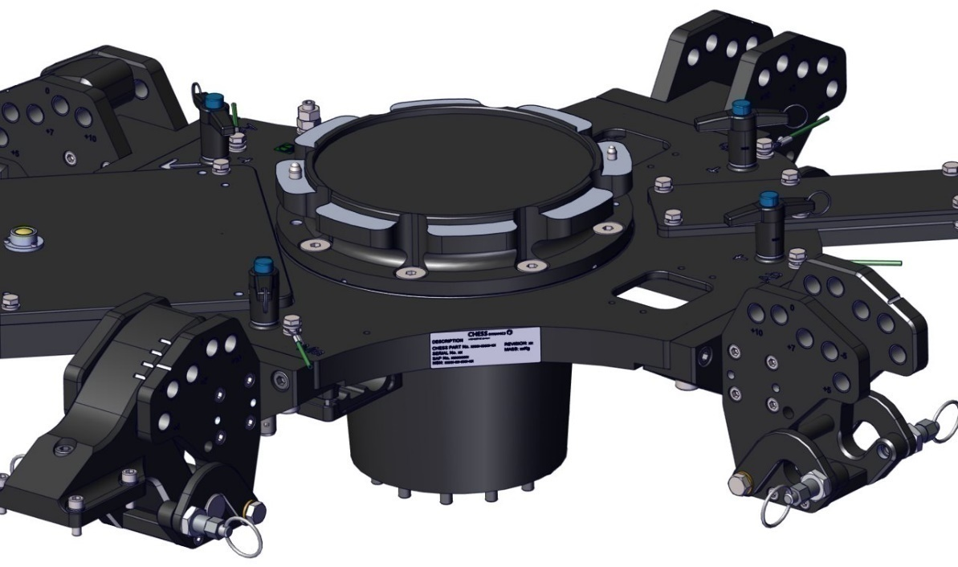
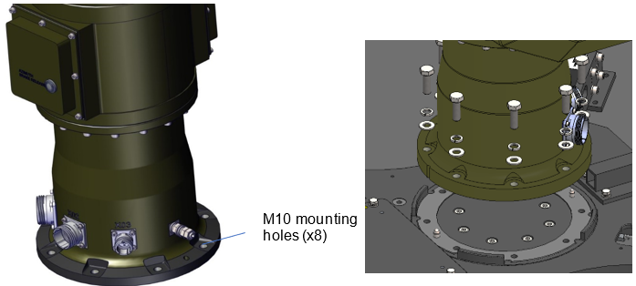
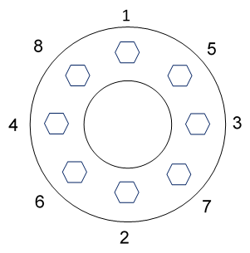
LRU Replacement – Viper Assembly
Replacing a Viper assembly
WARNING: All power must be removed from the system before starting this procedure
CAUTION: The assembly is heavy and will require at least two people to handle and fit.
Removing a Viper assembly
Disconnect and remove the surveillance pod and ECS RF Defeat CLAW and APLIQUE
Disconnect all cables from the base of Viper including Earth
Whilst two people are supporting the viper platform, use Allen keys to undo the 8 x M10 that secures the platform to the viper interface plate.
Using the carrying handles provided, lift the assembly away from the mast.
Using at least two people and the carrying handles provided, carefully lift the platform away from the viper interface plate.
To refit the viper, please follow the instructions in reverse, and tighten the bolts in the Pattern shown.
The Viper can only be fitted in one orientation due to Dowels.
8mm dowel
6mm dowel
Viper interface plate

Slide 3
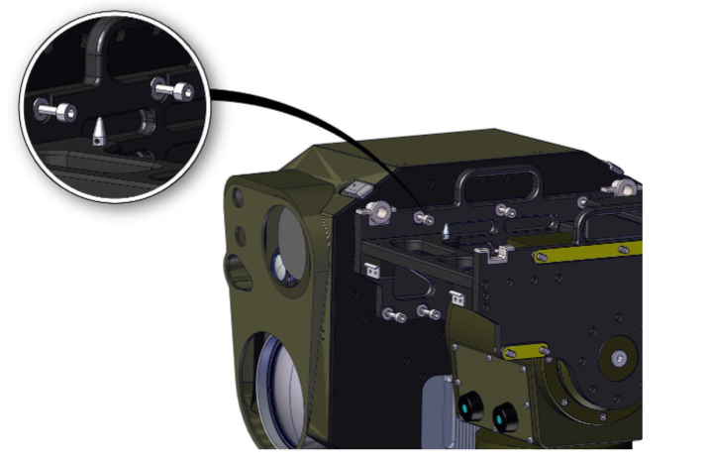
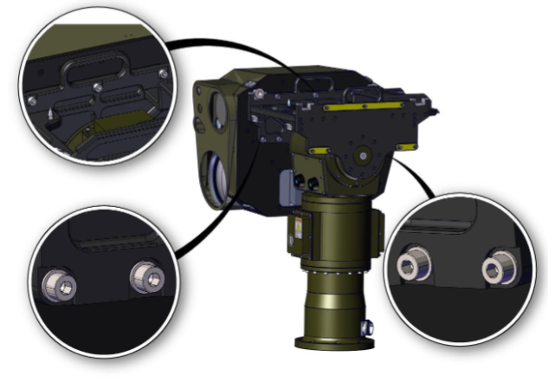
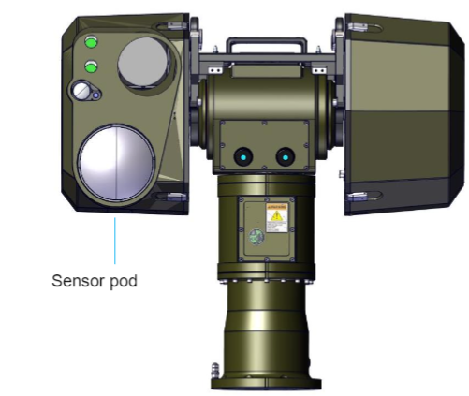
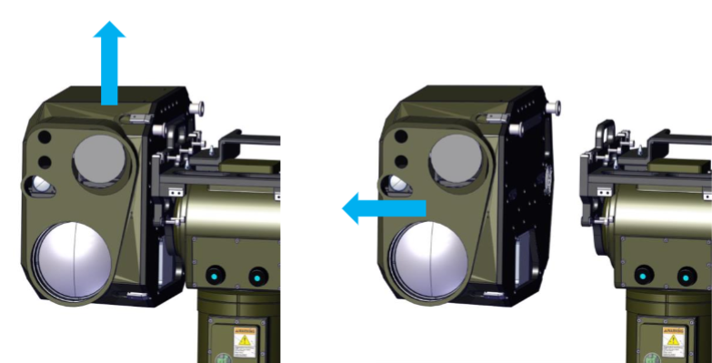
LRU Replacement – Surveillance Pod
Removal/Replacement of the surveillance pod
WARNING: All power must be removed from the system before starting this procedure.
CAUTION: Two people will be required to carry out this procedure.
Disconnect all the cables connected to the surveillance pod
Locate the 7 M8 captive screws that secure the sensor pod onto the Viper.
Loosen the securing screws making sure they are completely disengaged from the sensor pack.
Lift the sensor pack up off the location pins and then away from the viper.
To refit the sensor pack, reverse the above steps, tightening the captive screws to 21Nm

Slide 4
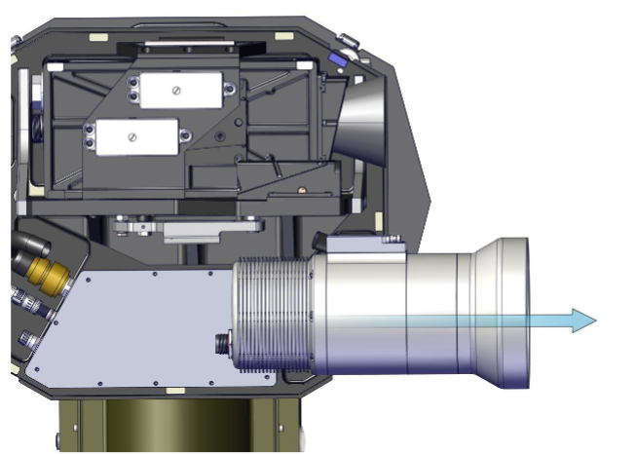
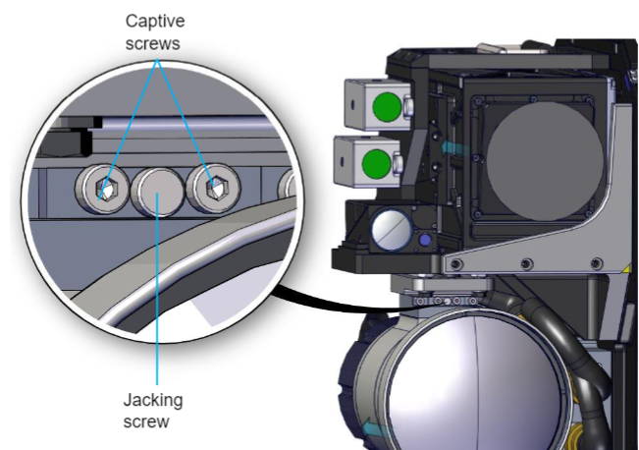
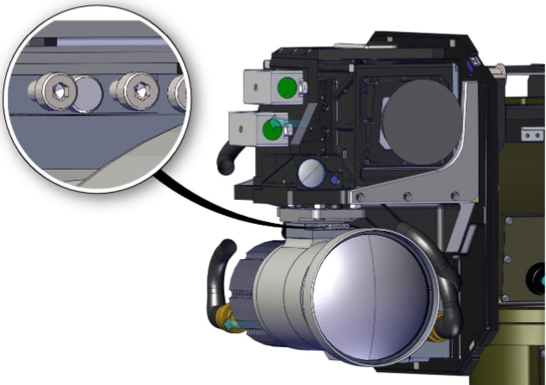
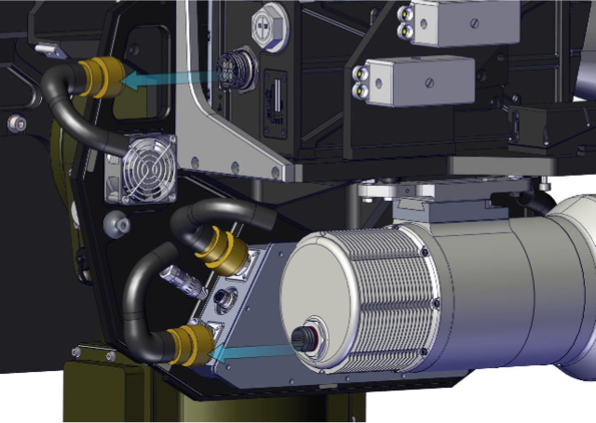
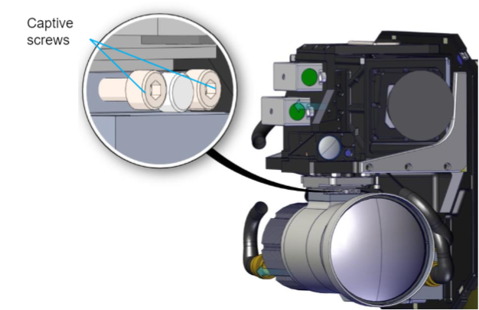
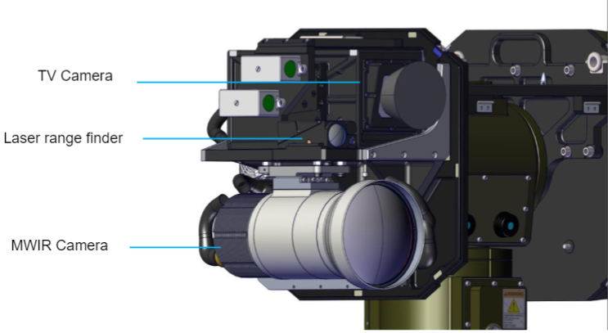
LRU Replacement – MWIR Sensor
Removing MWIR sensor
WARNING: All power must be removed from the system before starting this procedure
Remove the cover covering the sensors
Locate the correct sensor
Unplug the cables from the rear of the sensor
Undo the two captive screws at the rear of the dovetail, ensuring that the thread is completely disengaged
Undo the two captive screws making sure the thread is completely disengaged
Slowly screw in the centre jacking screw, which will begin to move the payload and unlock the dovetails
Slide the sensor forwards off the dovetail

Slide 5
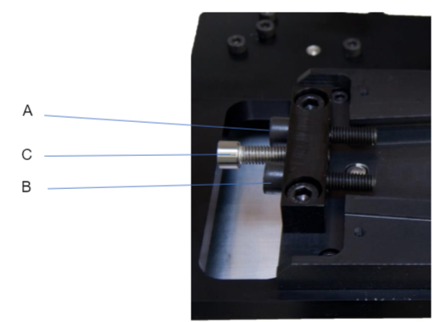
LRU Replacement – MWIR Sensor
Refitting MWIR sensor
WARNING: All power must be removed from the system before starting this procedure.
NOTE: Once the screws have been tightened enough for the torque wrench to click, it will still NOT have achieved 8 Nm of torque.
Clean both halves of the dovetail to ensure they are free from dirt and grease.
Check that the centre jacking screw is all the way out and not protruding into the dovetail.
Slide the sensor forward onto the mating half of the dovetail.
Using a torque wrench (set at 8Nm), tighten screw A and then screw B to gradually build up to the torque setting.
Repeat this process by alternating between the two screws.
Continue to tighten screw A then screw B until there is no movement on either screw. This should be at least 20 iterations from screw A to screw B
Once there is no movement on either screw, then 8Nm of torque has been achieved. Tighten up screw C to a torque of 1 Nm.

Slide 6
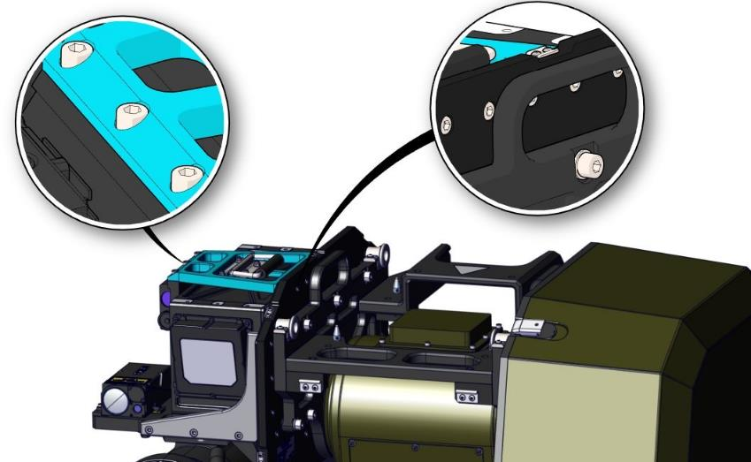
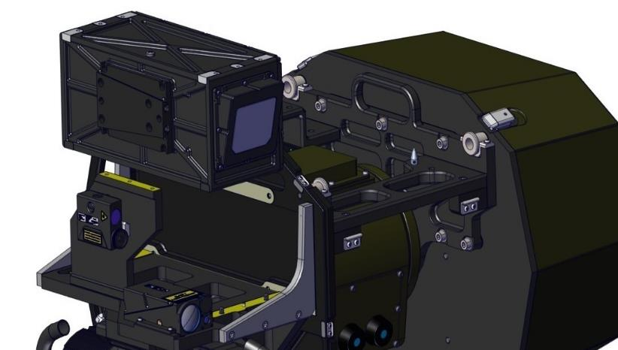
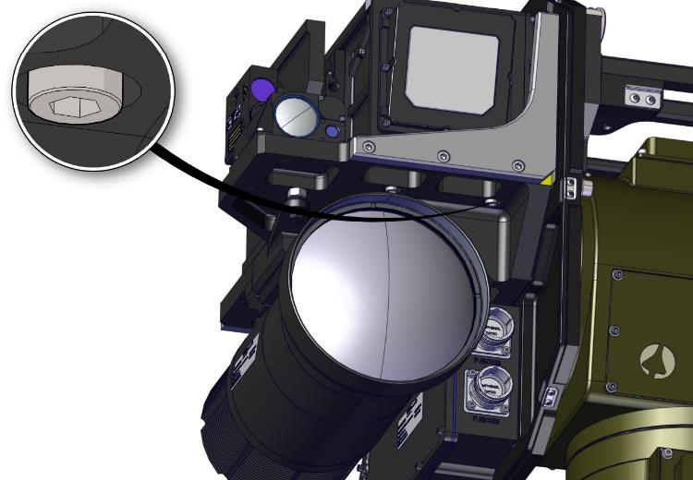
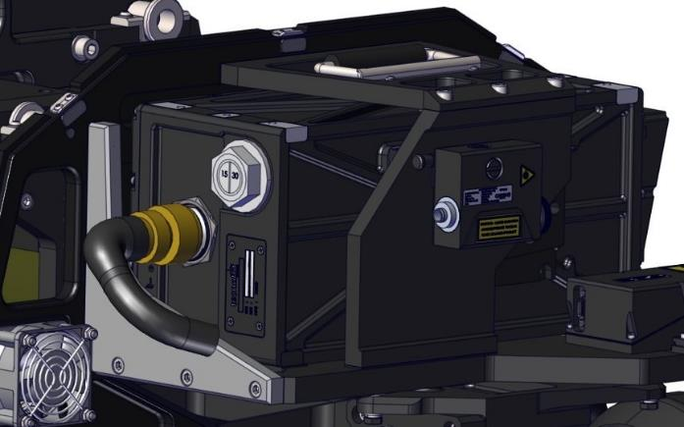
LRU Replacement – TV Camera
Removing TV Camera
WARNING: All power must be removed from the system before starting this procedure
Remove the Surveillance pod cover
Locate the correct sensor
Unplug the cables from the rear of the sensor
Remove the eight M6 hex skt caphead screws from the top brace and the back of the payload bracket. The top brace is highlighted in blue.
Remove the top brace
Beneath the camera, undo the four M6 captive screws securing the camera to the sensor mounting plate
Camera can then be removed from the system

Slide 7
LRU Replacement – TV Camera
Refitting TV Camera
WARNING: All power must be removed from the system before starting this procedure
Position the TV Camera in its mounting position.
There is a Dowel at the front and back of the camera to aid location.
Tighten the four M6 captive screws that secure the base of the camera to the sensor mounting plate
Replace the top brace plate and insert the eight M6 skt head screws; three to secure the top brace plate to the laser pointer mounting plate and five to secure it to the payload plate
Replace connecting cable and the Payload cover

Slide 8
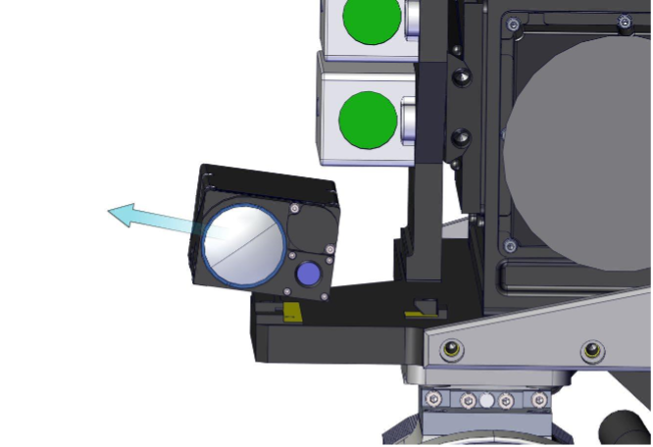
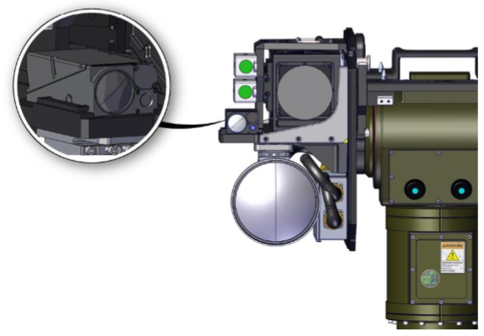
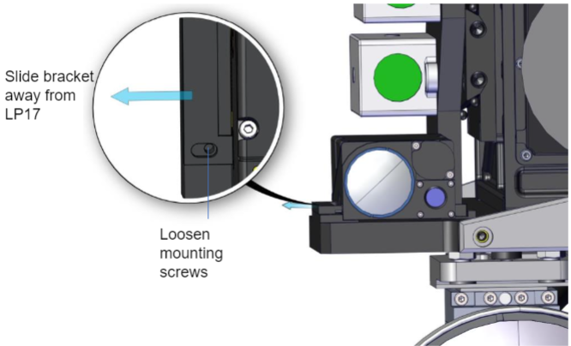
LRU Replacement – LP17
Replacing the LP17 Laser Range Finder
WARNING: All power must be removed from the system before starting this procedure
Locate the LP17 LRF
Remove all cables from the LP17
Loosen the screws holding the mounting clamp in place
Slide the mounting bracket away from the LP17
Slightly rotate and lift the LP17 away from the payload bracket
To refit the LP17, reverse the above steps
Notes:
1nm, 2.5mm hex key. Alignment per section 3.7.

Slide 9
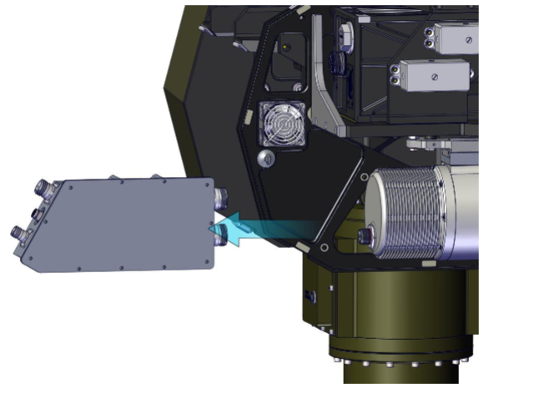
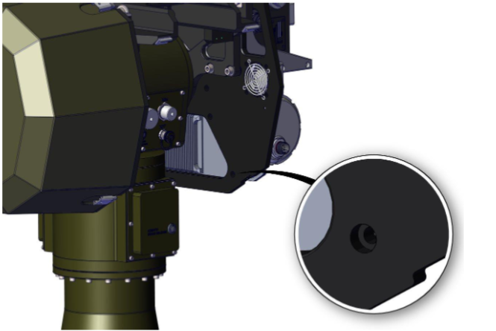
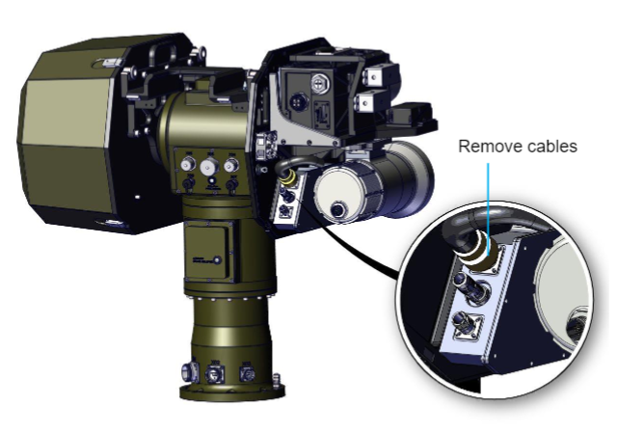
LRU Replacement – Payload Junction Box (PJB)
Removing the payload junction box
WARNING: All power must be removed from the system before starting this procedure
Remove the payload cover
Locate the junction box
Remove all the cables from the junction box
Remove the MWIR as detailed in an earlier section to allow access to the PJB
Remove the four screws holding the junction box to the payload bracket
Lift the junction box away from the payload bracket
To replace to payload junction box, reverse the above steps
Note: It will be necessary to remove the Thermal camera to allow the PJB to be removed.
Notes:
5mm hex. 9.6nm. No Loctite. Remove, refit and realign MWIR?

Slide 10
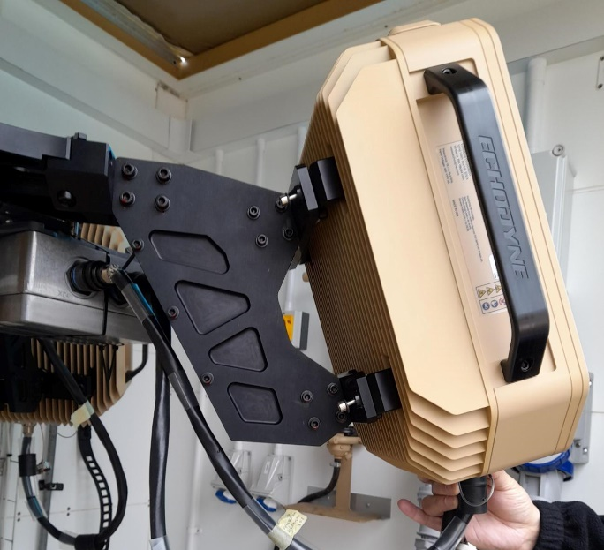
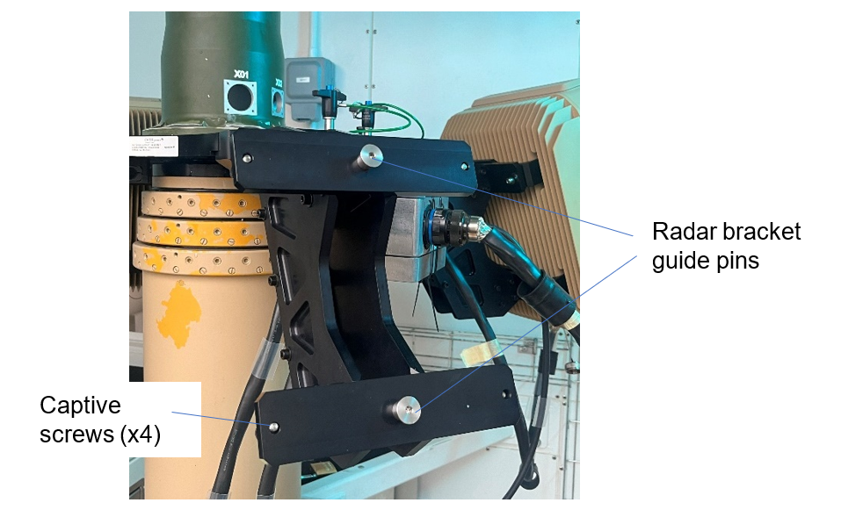
LRU Replacement - Radars
Replacing a radar panel
WARNING: All power must be removed from the system before starting this procedure.
Locate the radar to be replaced
Remove cable from the base of the Radar unit.
Undo the 4 captive screw securing the radar to the bracket.
Lift the radar unit up and away from the bracket as the unit sits on guide pins.
To replace the radar, reverse these steps
Notes:
Note, Panels have defined IP addresses and need to be in the correct locations on the cruciform for the system to orientate tracks correctly.

Slide 11
LRU Replacement - Radars
Replacing a radar panel
If a panel has been replaced.
Radars are supplied with a base address of 192.168.1.150, however could be another address if taken from another system.
Connect only this radar to the system and ping the address to check.
Run the “Change Radar IP” from Utilities
Set original address and new address as prompted within the utility
Note: If no CMS SW is running an error may be displayed in the CMD output.
Notes:
Note, Panels have defined IP addresses and need to be in the correct locations on the cruciform for the system to orientate tracks correctly.

Slide 12
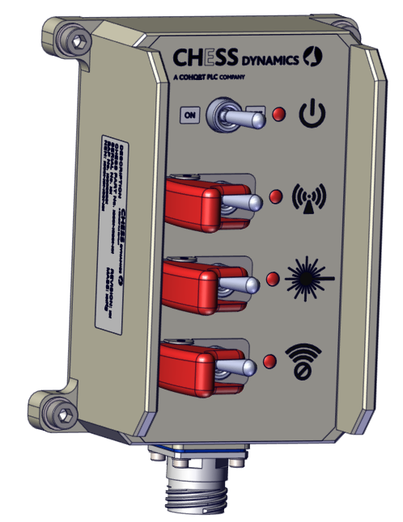
LRU Replacement – Switch Box
Replacing the systems switch box
WARNING: All power must be removed from the system before starting this procedure.
Locate the switchbox
Remove the cable from the switch box
Undo the 4 M6 captive screws which hold the switch box on to the bracket
Remove the switch box
To refit the switch box, reverse these steps

Slide 13
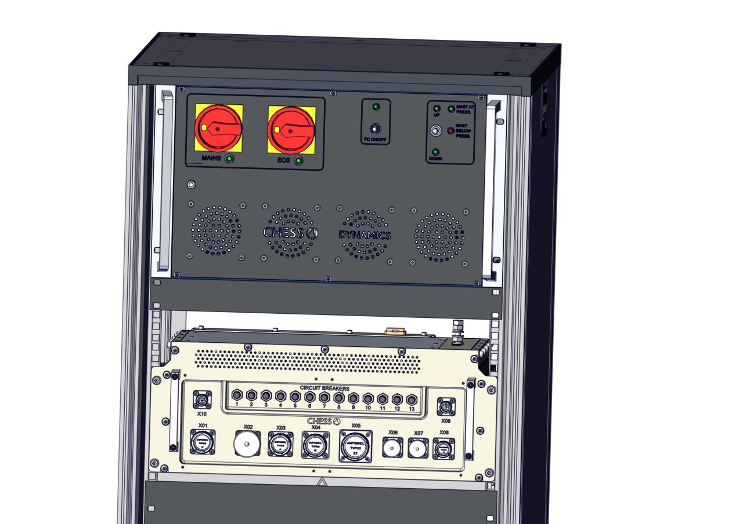
LRU Replacement – RJB
Replacing the rack junction box
WARNING: All power must be removed from the system before starting this procedure.
Locate the rack junction box in the Equipment rack, remove side panel of the rack to allow access
Remove all cables from the front and rear of the RJB remove the earth connection
Remove the securing screws on the front of the rack
Using the handles provided slide the junction out of the rack
To refit the grip and the junction box, reverse these steps.
Notes:
Earth connection is on the top of the unit, so other panel may need to be removed for access.
When the front screws are removed, you made loosen the rail blocks to allow removal, we can look at this on the system.

Slide 14
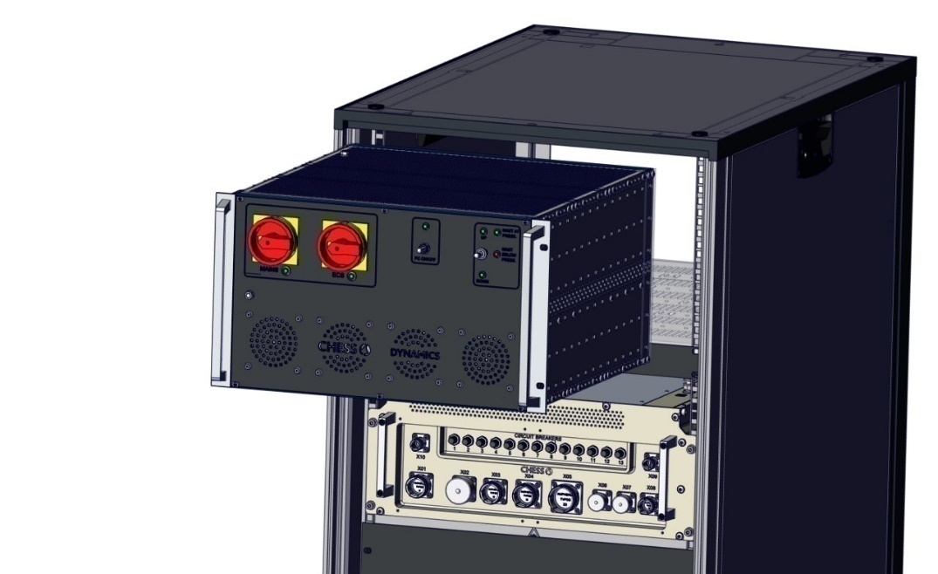
LRU Replacement – Rack PSU
Replacing the rack junction box
WARNING: All power must be removed from the system before starting this procedure.
Locate the rack PSU in the Equipment rack, remove side panel of the rack to allow access
Remove all cables from the front and rear of the PSU and the earth connection
Remove the 4 securing screws on the front of the rack
Using the handles provided slide the PSU out of the rack.
To refit the PSU, reverse these steps.
Notes:
Loctite 243

Slide 15
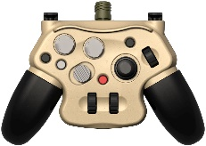
LRU Replacement – Hand Controller
Replacing the SCPI Hand controller
WARNING: All power must be removed from the system before starting this procedure.
Removing the SCPI hand controller
Ensure that power has been removed from the system.
Disconnect the 2105-W65 cable from the hand controller.
Refitting the SCIP hand controller
Ensure that power has been removed from the GRIP.
Connect cable 2105-W65 to the hand controller and the X03 connector on the GRIP.

Slide 16
LRU Replacement
Questions?

Slide 17
LRU Replacement
Practical Session
Safe removal and re-fitting of system LRU’s

